Slide 1


Sales Forecast
Teboho Maake

Slide 2

Content
-
•Introduction to the Project
•Data and Preprocessing
•Key Observations
•Methodology and Model Development
•Model testing
•Visual Insights
•Business Impact
•Challenges and Lessons Learned
•Conclusion and Next Steps

Slide 3
Introduction i
Background & Motivation
Sales forecasting is a critical task for retail businesses, helping them optimize inventory, manage supply chains, and maximize revenue. Walmart, one of the largest global retailers, relies on accurate sales predictions to ensure smooth operations across its stores. However, sales patterns are influenced by multiple factors such as seasonality, holidays, economic conditions, and even weather.
In this project, we aim to develop a machine learning-based sales forecasting model using Walmart's historical sales data. By leveraging past sales trends and external variables, we can predict future sales and provide actionable insights for better decision-making.

Slide 4
Introduction 1i
Problem Statement: In the competitive retail industry, inaccurate sales forecasts lead to overstocking (resulting in markdown losses) or understocking (lost sales opportunities). For a giant like Walmart, with thousands of stores and billions in revenue, even small forecasting errors can have significant financial and operational impacts.
Objective: Develop a predictive model to forecast weekly sales across Walmart stores, leveraging historical data and advanced analytics to improve inventory management and revenue optimization.
Context and Significance: Retail sales forecasting is a cornerstone of supply chain efficiency. With seasonal trends, economic factors, and holiday spikes influencing demand, accurate predictions are vital for strategic planning, customer satisfaction, and cost reduction. This project addresses these challenges using a data-driven approach tailored to Walmart’s diverse store network."

Slide 5

Data & Preprocessing
Dataset
Walmart sales data (2010-2012) with features: Weekly_sales,Holiday_flag, Temperature, Fuel_price, Unemployment and date
Preprocessing steps
•Convert date to day, month, year and added Lag_1, Lag_2
•Create Holiday_Month Interaction • Removed influential points using Cook’s Distance (removed X points)
.
.
.
.

Slide 6
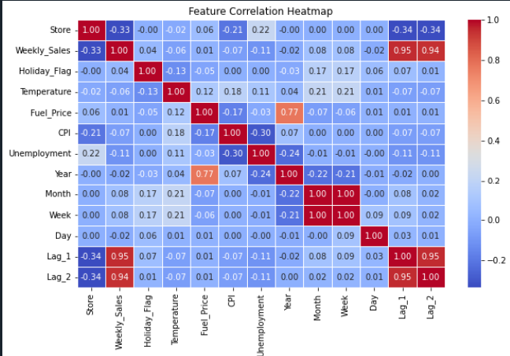
Key Observations:
•High correlation (Multicollinearity concerns):
-Month and Week (1.00): These two features are essentially capturing the same information (time progression within a year), leading to perfect correlation.
• Low/No Correlations:
-Fuel price doesn’t seem to have a strong linear relationship with sales or other features.
-The day of the month doesn’t show strong linear relationships with other features.
Moderate Correlations:
-Temperature with Month and Week (0.21 and 0.22): Temperature varies seasonally, so it correlates with time features.
-Holiday_Flag with Weekly_Sales (0.04): A weak positive correlation, suggesting holidays might slightly boost sales.
-Unemployment with Weekly_Sales (-0.11): A weak negative correlation, indicating higher unemployment might slightly reduce sales.

Slide 7
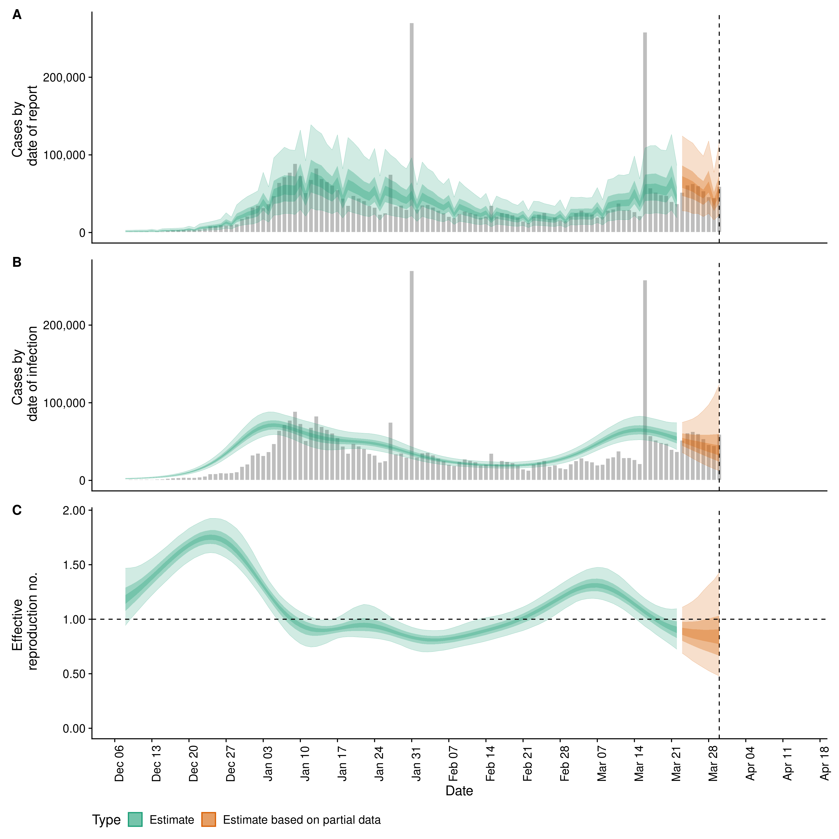
Key Observations ii
Implications:
•Multicollinearity: The high correlation between Month and Week, and between Lag_1 and Lag_2, can cause issues in some models (e.g., linear regression), leading to unstable coefficients. Random Forest, however, is generally robust to multicollinearity, but we can still simplify the model by removing redundant features.
• Feature Selection: Features with low correlation to Weekly_Sales (e.g., Fuel_Price, Day) might not contribute much to the model, but we’ll keep them for now since Random Forest can handle less relevant features through feature importance.
Business insight:
The strong correlation of Lag_1 and Lag_2 with Weekly_Sales suggests that past sales are a strong predictor of future sales.
The weak correlation of Holiday_Flag with Weekly_Sales (0.04) might indicate that holidays have a smaller impact than expected, or the effect varies by store.

Slide 8
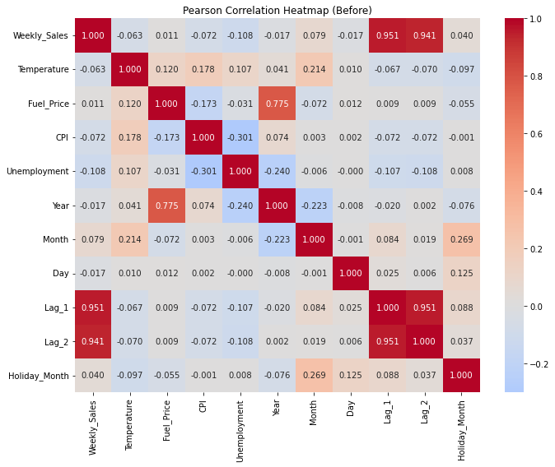
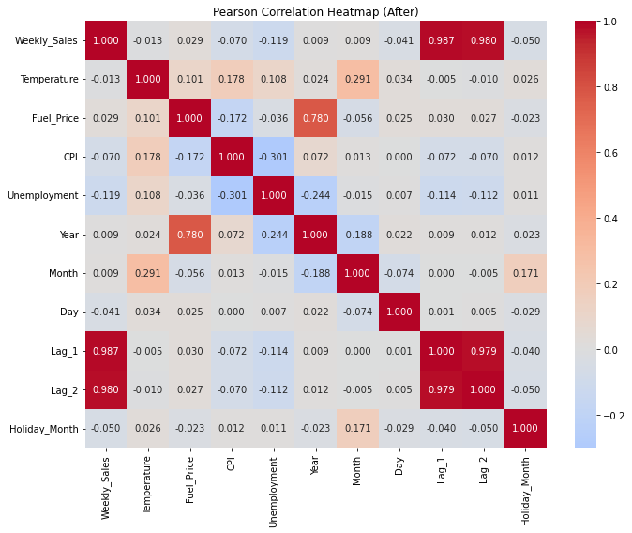
Key Observations iii:

Slide 9
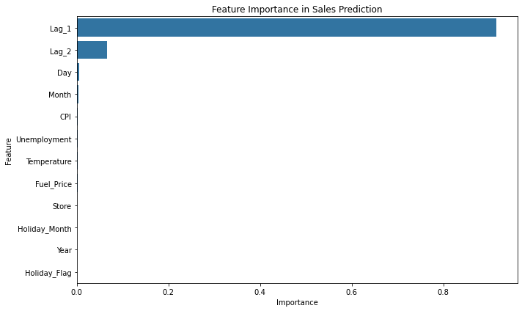
Methology & model development
Model evaluation
Approach
MAE: $ 42,754.32
RMSE: $ 63,052.86
R²: 0.9865
High Predictive Power: This is an exceptionally high R², indicating that the model fits the data very well. It suggests that the features I selected (e.g., lagged sales, economic indicators, temporal features) are highly relevant to predicting sales.
Business Implications: For Walmart, this means the model can reliably predict weekly sales, which is crucial for inventory planning, reducing stockouts, and minimizing overstock losses.
Random Forest Regressor with feature engineering and outlier removal
Features: Store, Holiday_Flag, Temperature, Fuel_Price, CPI, Unemployment, Year, Month, Day, Lag_1, Lag_2, Holiday_Month.

Slide 10
Model Testing
Store_ID | Date | Fuel_Price | Unemployment | Holiday_flag | Temperature | CPI | Previous sale |  | Output
1 | 2025-03-17 | 3.5 | 7.0 | 0 | 60.0 | 220 | -1 and -2 For lag_1 and Lag_2 |  | $1,472,894.87

Slide 11

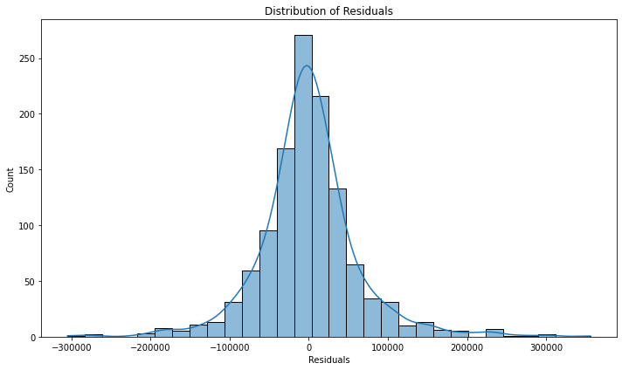
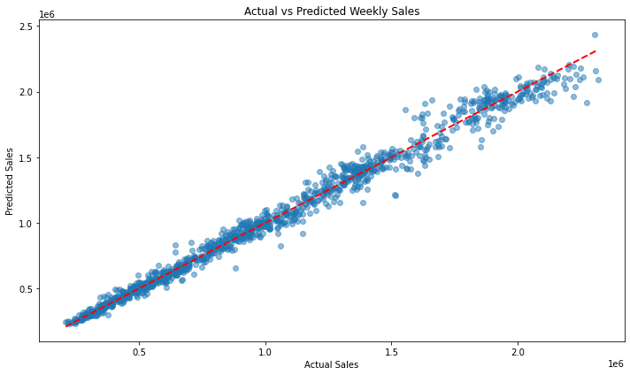
Visual Insights
Nearly 95% of points are around 45 degree line, indicating normality
Residuals are normally distributed based on the graph

Slide 12

Business Impact
Practical Applications:
Optimize inventory to reduce markdowns and stock-outs.
Improve revenue forecasting for strategic planning
Potential value:
Accurate forecasts can enhance decision-making and profitability.

Slide 13

Challenges & Lessons Learned
Challenges:
Handling multicollinearity (e.g., Month vs. week)
Balancing outlier removal with Holiday peak
Lessons Learned:
Importance of features engineering (e.g., lag variables)
Value of outlier analysis for Robust Models

Slide 14

Conclusion and Next Steps
Summary:
The model provides accurate and data-driven sales forecasts
Implementing this model can save costs and boost profitability
.

Slide 15


Next steps
Deploy model
Incorporate real time data
Test advanced models
.
Prophet, deep learning or XGBoost
.

Slide 16

Thank you
"Without data, you're just another person with an opinion." – W. Edwards Deming
Email: tebohomaake@gmail.com

